Slide 1
ShopSphere E-Commerce Analytics
DATA ENGINEERING ASSIGNMENT
From raw files to a dimensional model and eight KPIs

Slide 2
Data cleaning and quality scorecard
Fixed typos in segments, status and channel values
Parsed mixed date formats and ₹ amounts
Rejected orphan rows and recomputed line totals
Loaded the star schema into SQLite
File | Raw rows | Clean | Pass rate
customers | 163 | 157 | 96.3%
orders | 323 | 298 | 92.3%
order_items | 802 | 712 | 88.8%
payments | 329 | 295 | 89.7%
products | 75 | 70 | 93.3%
returns | 68 | 50 | 73.5%
suppliers | 19 | 18 | 94.7%
Source: data_quality_scorecard

Slide 3
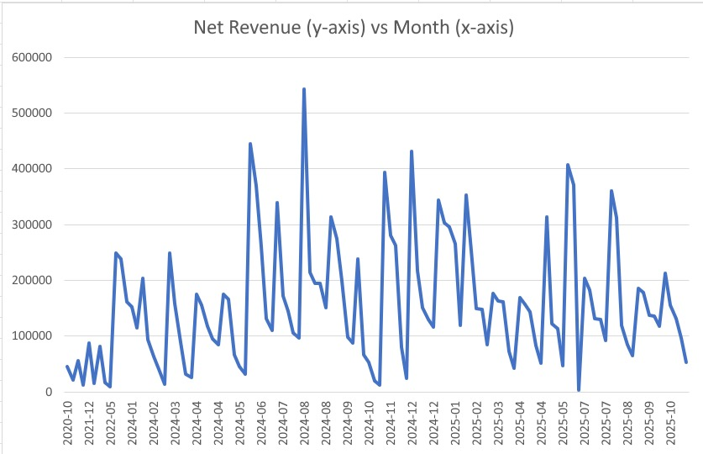
KPI 1: Net revenue by month
Net revenue is gross sales on completed orders minus approved refunds
Monthly revenue swings sharply, peaking near 540K in mid-2024
Most months fall between 50K and 350K
Source: kpi1_net_revenue

Slide 4
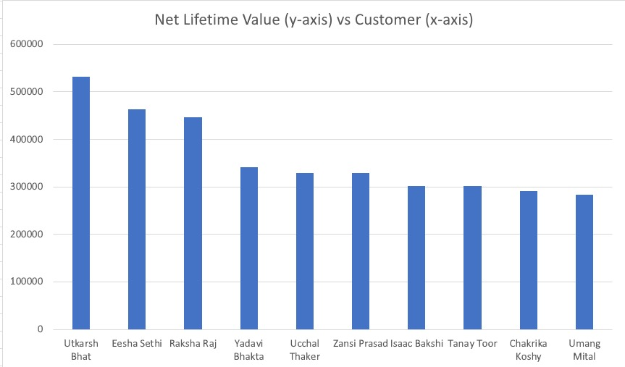
KPI 2: Top 10 customers by net lifetime value
Utkarsh Bhat leads at about 532K
Eesha Sethi and Raksha Raj follow at roughly 464K and 446K
Top customers are not tied to one segment
Source: kpi2_top_customers

Slide 5
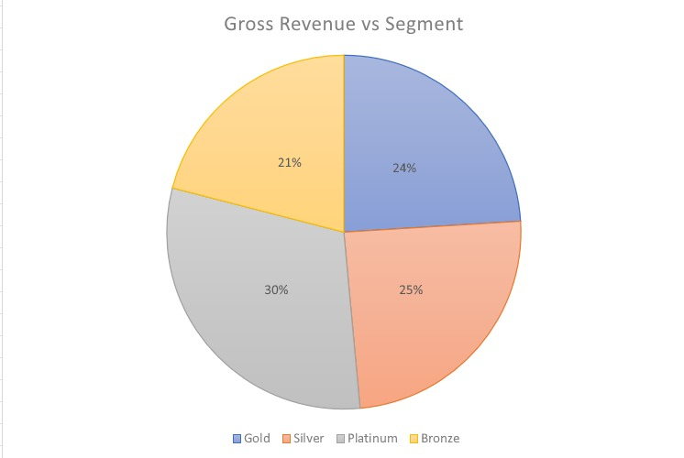
KPI 3: Customer segment profile
Platinum brings the largest share of revenue at 30%
Gold has the highest average order value at about 97.7K
Bronze is the smallest share at 21%
Source: kpi3_segments

Slide 6
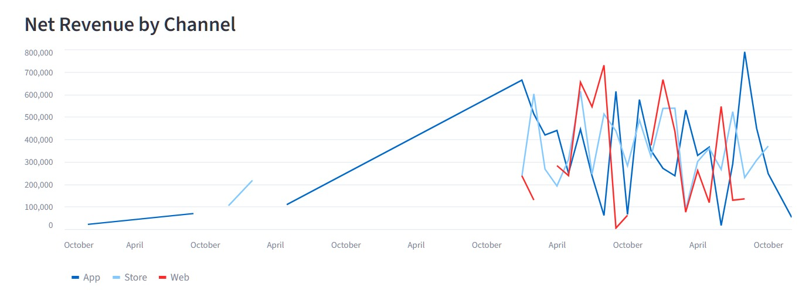
KPI 4: Month-over-month growth by channel
App, Store and Web all swing strongly month to month
App reaches the highest peak, close to 790K
Web data begins late and has gaps
Source: kpi4_mom_growth

Slide 7
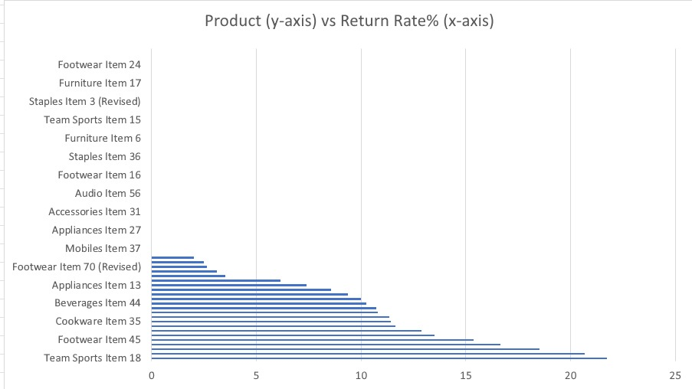
KPI 5: Product return rate
Team Sports Item 18 has the highest return rate at about 22%
Many products have no approved returns
A few high-return products drive most of the refund risk
Source: kpi5_return_rate

Slide 8
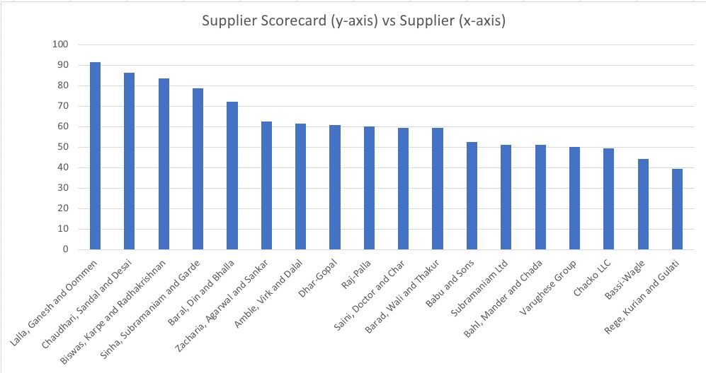
KPI 6: Supplier performance scorecard
Score blends revenue (50%), rating (30%) and return rate (20%)
Lalla, Ganesh and Oommen ranks first at about 91
Scores fall to the high 30s at the bottom of the list
Source: kpi6_suppliers

Slide 9
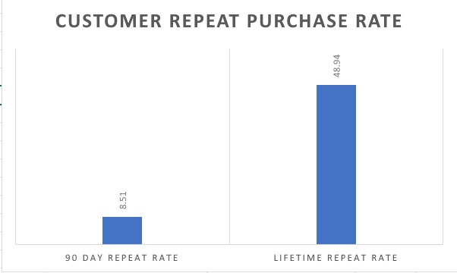
KPI 7: Customer repeat-purchase rate
Only 8.5% of customers buy again within 90 days
Lifetime repeat rate is 48.9%
Early retention is the main opportunity
Source: kpi7_repeat_rate

Slide 10
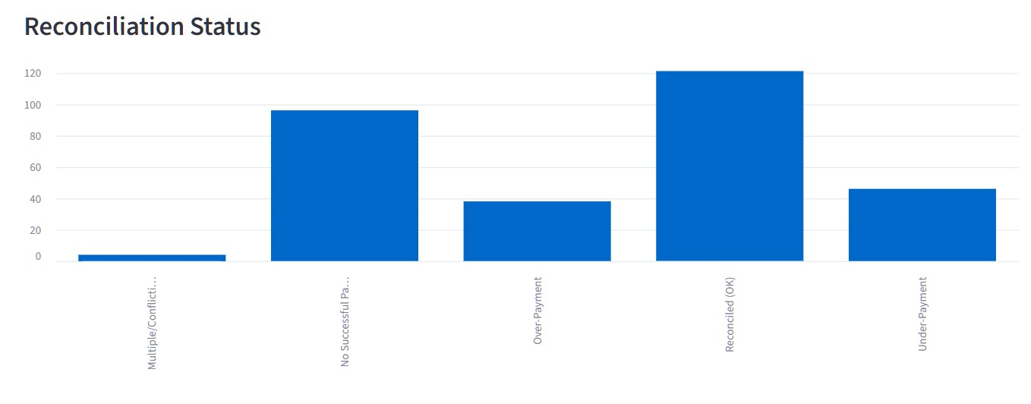
KPI 8: Payment reconciliation
About 122 orders reconcile cleanly
About 97 orders have no successful payment
Under-payments (about 46) and over-payments (about 38) need review
Source: kpi8_payment_anomalies

Slide 11
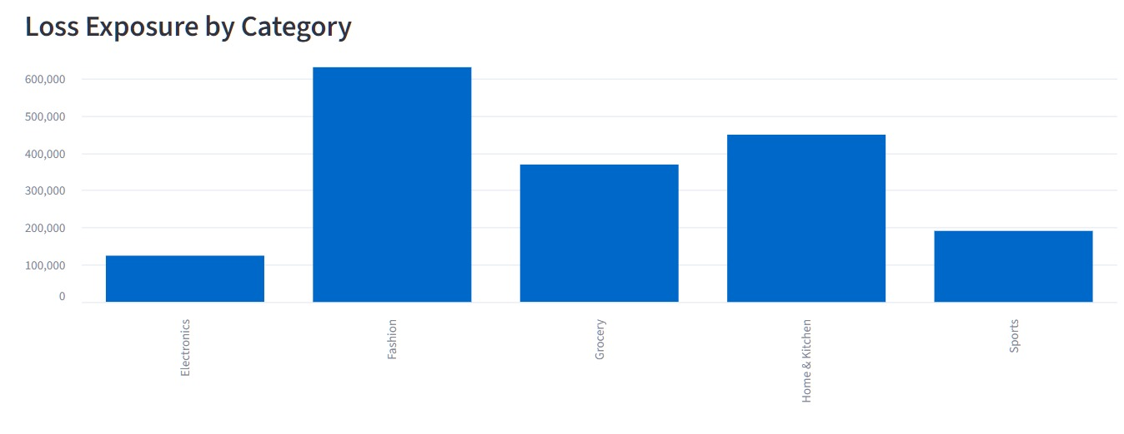
Stretch KPI: Margin risk by category
12 products have a cost price above the selling price
Fashion carries the largest loss exposure, about 630K
Home & Kitchen and Grocery follow
Source: kpi_stretch_margin

Slide 12
Key takeaways
Fix pricing
Recover payments
Grow retention
Cut returns
Reprice or retire loss-making products, starting with Fashion.
Lift the 90-day repeat rate with early follow-up offers.
Investigate high-return products and low-scoring suppliers.
Chase the orders with no successful payment and review over- and under-payments.

